Slide 1

C Programming Basic – week 14
http://www.4shared.com/file/59509094/77e868ab/week14.html
Mapping and Hashing
Lecturers :
Cao Tuan Dung
Le Duc Trung
Dept of Software Engineering
Hanoi University of Technology

Slide 2
Topics of this week
Dictionary ADT
Hash Table
Hash functions
Compression maps
Collision handling
Exercises

Slide 3

Dictionary ADT
The dictionary ADT models a searchable collection of key-element items
The main operations of a dictionary are searching, inserting, and deleting items
Multiple items with the same key are allowed
Applications:
  address book
  credit card authorization
  mapping host names (e.g., csci260.net) to internet addresses (e.g., 128.148.34.101)

Slide 4
Dictionary ADT methods
  findElement(k): if the dictionary has an item with key k, returns its element, else, returns the special element NO_SUCH_KEY
  insertItem(k, o): inserts item (k, o) into the dictionary
  removeElement(k): if the dictionary has an item with key k, removes it from the dictionary and returns its element, else returns the special element NO_SUCH_KEY
  size(), isEmpty()
  keys(), elements()

Slide 5
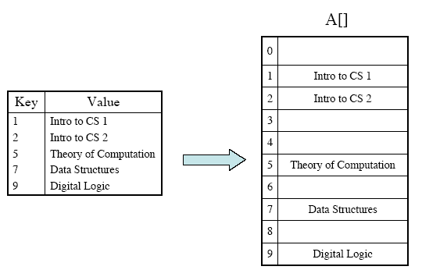
Key-Indexed Dictionaries
Space-efficient only if the cardinality of the set is close to N

Slide 6
Searching without Comparisons
How could a search algorithm proceed without comparing data elements?
What if we had some sort of “oracle” that could take the key for a data value and compute, in constant-bounded time, the location at which that key would occur within the data collection?
data key K
O(1)
Oracle
L_{i}
location of matching record
within the collection
If the container storing the collection supports random access with Θ(1) cost, as an array does, then we would have a total search cost of Θ(1).
Notes:
If the container storing the collection supports random
access with Θ(1) cost, as an array does, then we would
have a total search cost of Θ(1).

Slide 7
Hash Functions and
Hash Tables
An efficient way of implementing a dictionary is a hash table.
Use an array (or list) of size N (table)
  Need to spread keys over range [0,N-1]
  Collisions occur when elements have same key
Keys are not always integers, nor in range [0,N-1]
A hash table for a given key type consists of
  Hash function h
  Array (called table) of size N
When implementing a dictionary with a hash table, the goal is to store item (k, o) at index i = h(k)

Slide 8
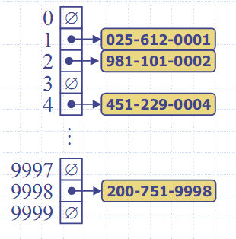
Example
We design a hash table for a dictionary storing items (SIN, Name), where SIN (social insurance number) is a nine-digit positive integer
Our hash table uses an array of size N = 10,000 and the hash function
h(x) = last four digits of x

Slide 9
Hash functions
A hash function h maps keys of a given type to integers in a fixed interval [0, N − 1]
Example:
  h(x) = x mod N is a hash function for integer keys
  The integer h(x) is called the hash value of key x
A hash function is usually specified as the composition of two functions:
Hash code map:
  h1:keys → integers
Compression map:
  h2: integers → [0, N − 1]

Slide 10
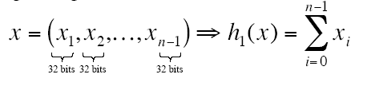
Hash Code Maps
Interger cast
  Bits of the key are interpreted as integer
  Suitable for keys of length shorter than the number of bits of an integer type
  Example:
    ‘A’ -> 65
    ‘N’ ->78
Component Sum
  We partition the bits of the key into components of fixed length (e.g., 16 or 32 bits) and we sum the components
  Suitable for numeric keys of fixed length greater than or equal to the number of bits of the integer type

Slide 11
Hash code Maps
Polynomial accumulation
  We partition the bits of the key into a sequence of components of fixed length (e.g., 8, 16 or 32 bits)
a₀ a₁ … a_{n−1}
  We evaluate the polynomial
p(z) = a₀ + a₁ z + a₂ z² + … + a_{n−1}z^{n−1}
at a fixed value z, ignoring overflows
  Especially suitable for strings (e.g., the choice z = 33 gives at most 6 collisions on a set of 50,000 English words)

Slide 12
Exercise 14.1
Write three function which implements three type of hash code maps above.
The input key for integer cast and polynomial is a string
The input key for component sum method is a number of type long.

Slide 13
Compression Map
The result of the HCM needs to be reduced to a value in [0,N-1]
Division Method:
  h₂(y) = |y| mod N
  The size N of the hash table is usually chosen to be a prime
Multiply, Add and Divide (MAD):
  h2(y) = |ay + b| mod N
  a and b are nonnegative integers such that a mod N ≠ 0
  Otherwise, every integer would map to the same value b

Slide 14
Simple implementation of Hash Table
#define MAX_CHAR 10
#define TABLE_SIZE 13
typedef struct {
char key[MAX_CHAR];
/* other fields */
} element;
element hash_table[TABLE_SIZE];

Slide 15
Hash Algorithm via Division
void init_table(element ht[])
{
int i;
for (i=0; i<TABLE_SIZE; i++)
ht[i].key[0]=NULL;
}
int transform(char *key)
{
int number=0;
while (*key) number += *key++;
return number;
}
int hash(char *key)
{
return (transform(key)
% TABLE_SIZE);
}

Slide 16
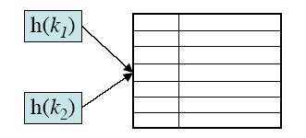
Conflict Resolution
Collisions - occur when k₁ ≠ k₂ but h(k₁) = h(k₂)
Results in more complex insertItem() and findElement() operations
Conflict Resolution Strategies
  Closed Addressing (Open Hash Table) - i.e. slots other than h(k) are “closed” and can not be used
  Open Addressing (Closed Hash Table)- look for another open position in the table

Slide 17
Data structure for Hash Table
Open Hash Table:
  Chaining Method
Closed Hash Table
  Linear Probing
  Quadratic Probing
  Rehashing

Slide 18
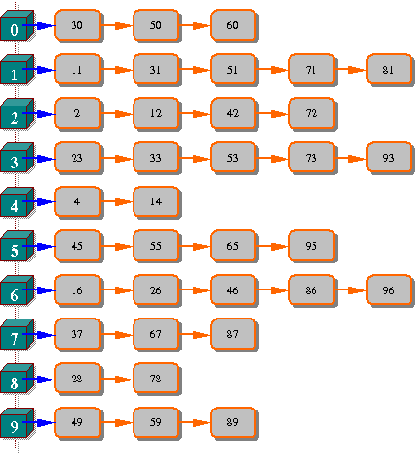
Data structure for chaining
Array of pointers
Each pointer manage a linked list corresponding to a bucket (address).
This example shows a chaining hash table with hash function
  N mod 10

Slide 19
Exercise 14.1
Implement an ADT for chaining hash table providing the following operations:
  Init
  Hash function
  Insert (given key and element)
  Search, Delete (given key)
  IsEmpty
  Clear
  Traverse

Slide 20
Solution
Data structure declaration
#define B ... // size of hash table
typedef ... KeyType; // int
typedef struct Node
{
KeyType Key;
// Add new fields if it is necessary
Node* Next;
};
typedef Node* Position;
typedef Position Dictionary[B];
Dictionary D;

Slide 21
Initiate a Hash Table
void MakeNullSet()
{
int i;
for(i=0;i<B;i++)
D[i]=NULL;
}

Slide 22
Search an element in the hash table
int Search(KeyType X) {
Position P;
int Found=0;
//Go to bucket at H(X)
P=D[H(X)];
//Traverse through the list at bucket H(X)
while((P!=NULL) && (!Found))
if (P->Key==X) Found=1;
else P=P->Next;
return Found;
}

Slide 23
Insert an element
void InsertSet(KeyType X)
{
int Bucket;
Position P;
if (!Member(X, D)) {
Bucket=H(X);
P=D[Bucket];
//allocate a new node at D[Bucket]
D[Bucket] = (Node*)malloc(sizeof(Node));
D[Bucket] ->Key=X;
D[Bucket] ->Next=P;
}
}

Slide 24
Delete an element
void DeleteSet(ElementType X){
int Bucket, Done;
Position P,Q;
Bucket=H(X);
// If list has already existed
if (D[Bucket]!=NULL) {
// if X at the head of the list
if D[Bucket]->Key==X)
{
Q=D[Bucket];
D[Bucket]=D[Bucket]->Next;
free(Q);
}
else { // Search for X
Done=0;
P=D[Bucket];
while ((P->Next!=NULL) && (!Done))
if (P->Next->Key==X) Done=1;
else P=P->Next;
if (Done) { // If found
// Delete P->Next
Q=P->Next;
P->Next=Q->Next;
free(Q);
}
}
}
}

Slide 25
Emptiness
Verify if a bucket is empty
int emptybucket (int b){
return(D[b] ==NULL ? 1:0);
}
Verify if the table is empty
int empty( ){
int b;
for (b = 0; b<B;b++)
if(D[b] !=NULL) return 0;
return 1;
}

Slide 26
Clear a bucket
void clearbucket (int b){
Position p,q;
q = NULL;
p = D[b];
while(p !=NULL){
q = p;
p=p->next;
free (q);
}
D[b] = NULL;
}

Slide 27
Clear the hash table
void clear( )
{
int b;
for (b = 0; b<B ; b++)
clearbucket(b);
}

Slide 28
Traverse a bucket
void traversebucket (int b)
{
Position p;
p= D[b];
while (p !=NULL)
{
// Assume that the key is of int type
printf("%3d", p->key);
p= p->next;
}
}

Slide 29
Traverse the table
void traverse()
{
int b;
for (b = 0;n<B; b++)
{
printf("\nBucket %d:",b);
traversebucket(b);
}
}

Slide 30
Exercise 14-2 Make a hash list
You assume to make an address book of mobile phone.
You declare a structure which can hold at least “name,” “telephone number,” and “e-mail address”, and make a program which can manage about 100 these data.
(1) Read about 10 from an input file, and store them in a hash table which has an “e-mail address” as a key. Then confirm that the hash table is made. In this exercise, the hash function may always return the same value.
(2)Define the hash function properly, and make the congestion occur as rare as possible

Slide 31
Linear Probing
(linear open addressing)
Compute f(x) for identifier x
Examine the buckets
ht[(f(x)+j)%TABLE_SIZE]
0 ≤ j ≤ TABLE_SIZE
  The bucket contains x.
  The bucket contains the empty string
  The bucket contains a nonempty string other than x
  Return to ht[f(x)]

Slide 32
Linear Probing - example
0
49**
With linear probing f(i) = i.
1
58**
2
69**
3
Here is a hash table of size
T = 10, where the entries 89, 18,
49, 58, and 69 have been inserted.
The hash function is h(key) = key%10.
4
5
6
7
8
18
9
89
Throughout this talk we use a table size
T = 10, although in practice it should be prime.

Slide 33
Exercise 14.3
Implement an ADT Hash Table with linear probing method.

Slide 34
Solution: Data structure
#define NULLKEY –1
#define M 100 // size of hash table
struct node
{
int key;
};
//Declare hash table as an array
struct node hashtable[M];
int NODEPTR;
int N = 0;

Slide 35
Hash function and initialization
int hashfunc(int key)
{
return(key% 10); // or any number
}
void initialize( )
{
int i;
for(i=0;i<M;i++)
hashtable[i].key=NULLKEY;
N=0;
//so nut hien co khoi dong bang 0
}

Slide 36
Check the state of table
int full( ){
return (N==M-1 ? 1: 0);
}
int empty( ){
return (N==0 ? 1: 0);
}

Slide 37
Search
int search(int k){
int i;
i=hashfunc(k);
while(hashtable[i].key!=k && hashtable[i].key !=NULLKEY){
//rehash :fi(key)=f(key)+1) % M
i=i+1;
if(i>=M) i=i-M;
}
if(hashtable[i].key==k) // found
return i;
else // not found
return M;
}

Slide 38
Insert
int insert(int k){
int i, j;
if(full()){
printf("\n Hash table is full. Can not insert the key %d ",k);
return;
}
i=hashfunc(k);
while(hashtable[i].key !=NULLKEY){
// Rehash
i ++;
if(i>M) i= i-M;
}
hashtable[i].key=k;
N=N+1;
return i;
}

Slide 39
Remove a key
void remove(int i){
int j, r, a, cont=1;
do {
hashtable[i].key = NULLKEY;
j = i;
do {
i=i+1;
if(i>=M) i=i–M;
if(hashtable[i].key == NULLKEY)cont = 0;
else {
r = hashfunc(hashtable[i].key);
a = (j<r && r<=i)||(r<=i && i<j)||(i<j && j<r);
}
} while (cont && a);
if(cont) hashtable[j].key=hashtable[i].key;
} while(cont);
}

Slide 40
Quadratic Probing
Linear probing tends to cluster
  Slows searches
designed to eliminate the primary clustering problem of linear (but some secondary clustering)
uses a quadratic collision function i.e. f(i) = i²
no guarantee of finding an empty cell if table is > half full unless table size is prime

Slide 41
Exercise 14.4
Implement an ADT Hash Table with quadratic probing method.

Slide 42
Search
int search(int k) {
int i, d;
i = hashfunc(k);
d = 1;
while(hashtable[i].key!=k && hashtable[i].key !=NULLKEY){
//Quadratic probing
i = (i+d*d) % M;
d = d+1;
}
if(hashtable[i].key==k) // found
return i;
else // not found
return M;
}

Slide 43
Insert
int insert(int k){
int i, d;
if(full()){
printf("\n Hash table is full. Can not insert the key %d ",k);
return;
}
i=hashfunc(k); d = 1;
while(hashtable[i].key !=NULLKEY){
//Quadratic probing
i = (i+d*d) % M;
d = d+1;
}
hashtable[i].key=k;
N=N+1;
return i;
}

Slide 44
Double Hashing
Double hashing uses a secondary hash function h₂(k) and handles collisions by placing an item in the first available cell of the series
(i + h₂(k)) mod N
The secondary hash function h₂(k) cannot have zero values
The table size N must be a prime to allow probing of all the cells
Common choice of compression map for the secondary hash
function: h₂(k) = q − k mod q
where
  q < N
  q is a prime

Slide 45
Exercise 14.5
Implement an ADT Hash Table with rehashing method, using two following hash functions:
f1(key)= key % M
f2(key) =(M-2)-key %(M-2)

Slide 46
Hash functions
int hashfunc(int key)
{
return(key%M);
}
//Secondary function
int hashfunc2(int key)
{
return(M-2 – key%(M-2));
}

Slide 47
Search
int search(int k) {
int i, j ;
i = hashfunc (k);
j = hashfunc2 (k);
while(hashtable[i].key!=k && hashtable[i].key !=NULLKEY){
//Rehashing
i = (i+j) % M ;
}
if(hashtable[i].key==k) // found
return i;
else // not found
return M;
}

Slide 48
Insert
int insert(int k){
int i, j;
if(full()){
printf("\n Hash table is full. Can not insert the key %d ",k);
return M;
}
if (search (k) < M){
printf (“This key exist in the hash table") ;
return M ;
}
i = hashfunc(k); j = hashfunc2(k) ;
while(hashtable[i].key !=NULLKEY){
//Rehashing
i = (i+j) % M;
}
hashtable[i].key=k;
N=N+1;
return i;
}

